Slide 1
Abstractive News Summarization for Bangla Documents Using LSTM Network Model
Presented By -
Md.Shajib Hossain (19101250)
Md. Muhimenul Mubin
Mehnaz Ara Fazal, ST
Sania Azhmee Bhuiyan, RA

Slide 2
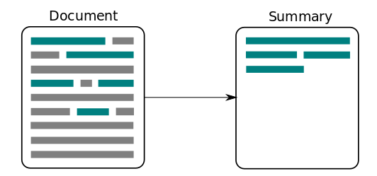
Introduction
2 types of summarization -
Abstractive
Extractive
Novel system for abstractive summarization of Bengali news articles.
LSTM network model with attention at encoder-decoder, designed to generate human-like sentences summarizing Bengali news documents
demonstrating significant improvement over existing approaches

Slide 3
Motivation and Purpose
To generate a meaningful idea over a large documents and save time
to contribute to the field of abstractive summarization, particularly in languages other than English, and to provide a valuable resource for Bengali news summarization.

Slide 4
Literature Review
Bengali extractive summarization based on document indexing and keyword-based information retrieval was first introduced by Islam et al
Kamal Sarkar a researcher who first proposed the idea of sentence ranking and stemming process-based Bengali extractive summarization. And after a period Efat et al.
The later years mainly in 2017, Abujar et al. \cite{b10} proposed a heuristic approach. And Akther et al.
In our study we have also seen that later on a foundation on Bengali extractive summarization approaches have been proposed using deep neural netwrok.

Slide 5
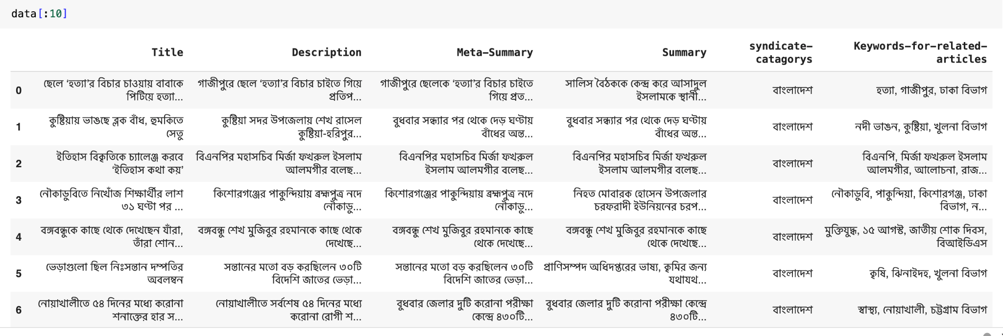
Dataset
Publicly available dataset on kaggle consisting over 19,000 Bengali news articles and their corresponding human-written summaries.
The dataset has the largest number of news summarization dataset
Has both the Actual news and Human-written summaries.

Slide 6
Methodology
Data Collection
Our Collected data has over 19,000 news articles along with its summaries
For our work we have worked only on 2 columns of the dataset (Description and Summary)
Had 6 different columns for each instances

Slide 7
The END

